Slide 1
Inferring R_t

Slide 2
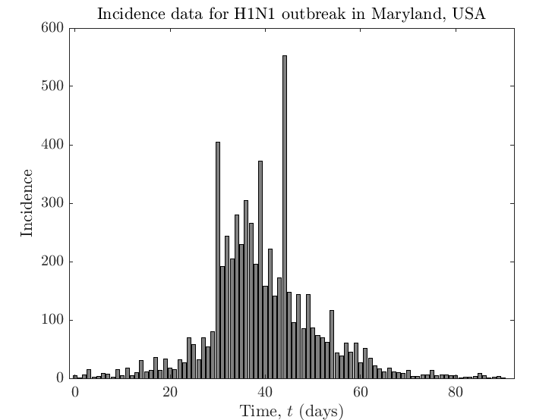
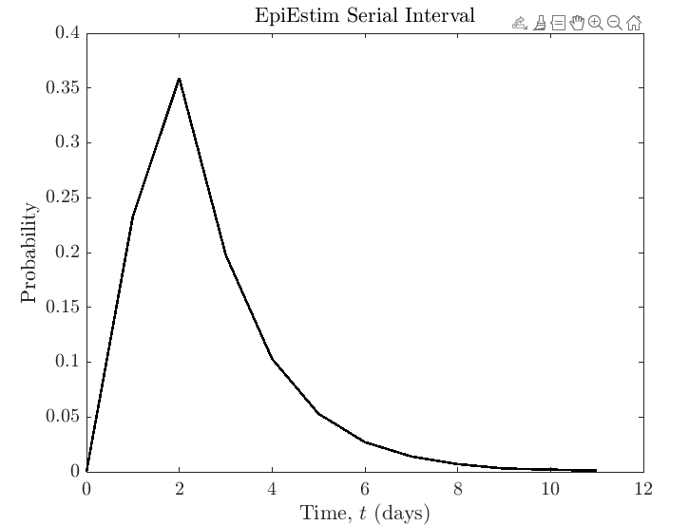
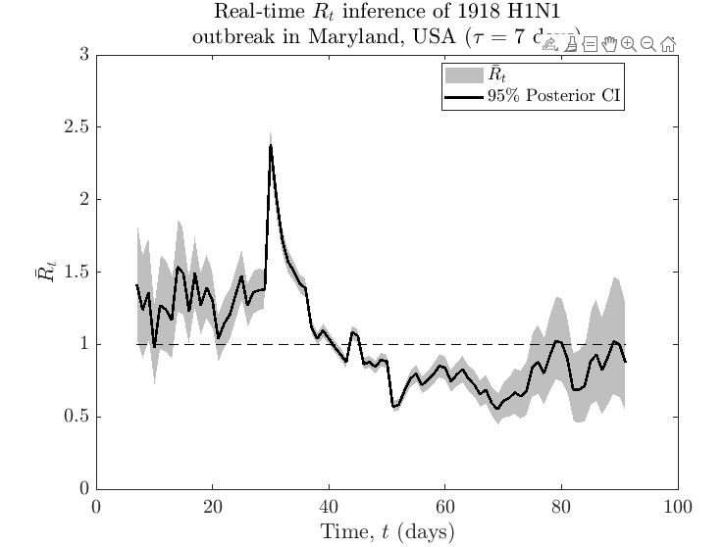
Inferring R_t
+
=

Slide 3
How to model varying serial intervals?

Slide 4
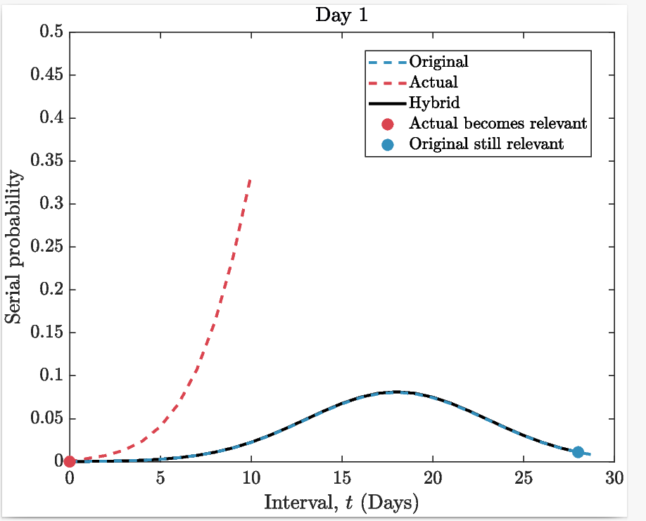
How to model varying serial intervals?

Slide 5
How to model varying serial intervals?

Slide 6
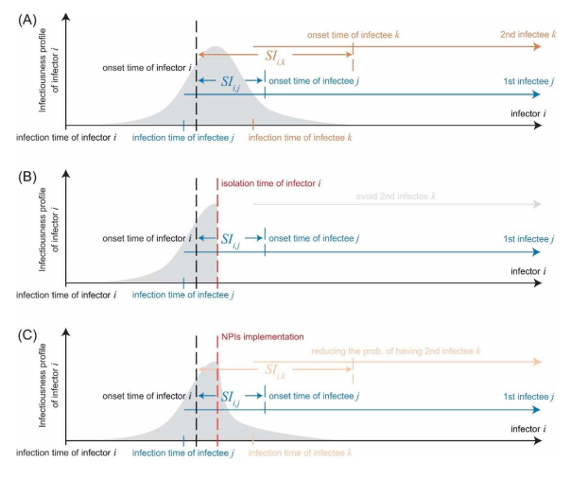
SI depends on infectivity profile, incubation period and population bheaviour

Slide 7
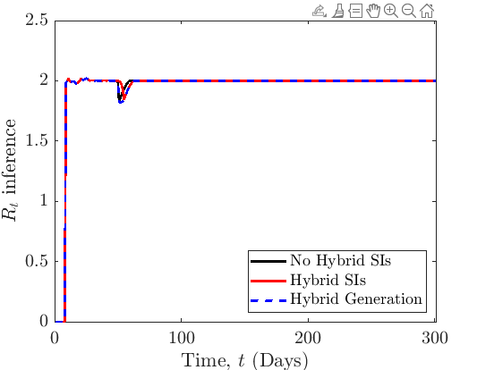
Trivial R inference with varying SIs
Incidence data is generated from a constant R (=2)

Slide 8
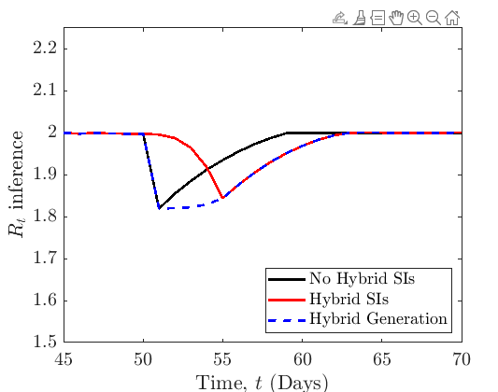
Which method is best?
Black inference is (I think) not using a good model. Red is (I think) the best using the most realistic model.

Slide 9
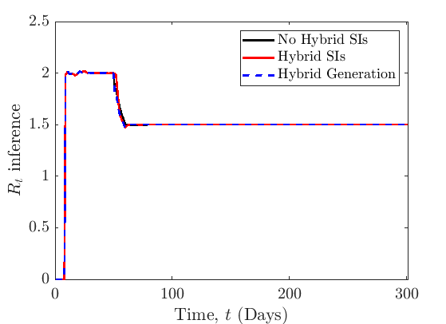
In reality, we’d expect something more like this:

Slide 10
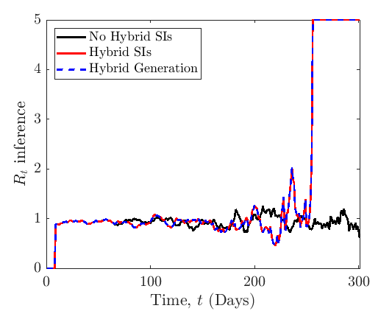
Black line and other colours are different models- only relevant in synthetic data generation

Slide 11
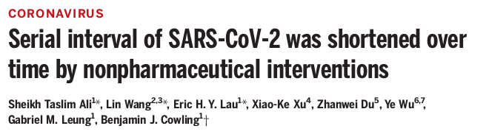
Idea
Use this paper to look at how R inference is different with and without using varying serial intervals AND with and without hybrid serial intervals
See how R_t inference tracks interventions
This paper also looks at continuously changing SIs

Slide 12
Another idea
Looking at how this model works when many local authorities use it simultaneously- i.e. weak transmission between them.

Slide 13
Ideal: Novel Case Study
Ideal situation is having data where we either: a) have the serial interval varying through time or b) have data where we can generate the serial interval in a sliding window.
Then we can use R_t inference using different techniques. Although in this kind of analysis, it’s tricky to decide which technique is optimum.

Slide 14
Issues
How to use negative serial intervals? This is very important for diseases like Covid.
However, I don’t think it is simple to implement this into our inference technique?
Is the hybrid solution useless? We need to have instant access to the new SI (unrealistic) and it is only helpful for a few days. More likely that SI prediction is useful/possible.

